Slide 1

EC Modeling
T-Mobile National Development
Naren Prabhakar, Sr. Manager Reporting & Analytics
Anastasia Stevens, Data Scientist
Pranshu Kumar, Data Scientist
Emily Wong, Business Analyst
Adam Cornille, QA

Slide 2
Project Overview
Project Objective
Predict how long it will take a project to reach Entitlement Complete using machine learning methods
Current State
EC estimation is currently based on calculating average EC filtered by market, MLA vendor, and POR type
Modeling Solution
Use the Urban Planning Data Source + T-Mobile project level data as features in a model
This method generates an error of ±3.35 months for King County
Goal is to get the MAE at least below 2 months for King County and predict EC duration within a margin of error of ± 1.5 months for 70% of the projects
Calculate the benefit of using parcel level zoning and jurisdiction boundary data by testing on a provided sample of King County data
Reducing this error will allow T-Mobile to reduce the soft cost WIP and eliminate inventory waste
Using historical average EC durations with outliers removed, our current margin of error (MAE) nationwide is ± 2.7 months
Notes:
For the 410 points, how many are we predicting +- 1 month
Percentage of PORs that are +- 1 month
Market want to build 100, work on 150 instead of 200

Slide 3
Modeling Overview
Source
Selected Features
T-Mobile
POR Data
Property Indicator: Single-Family, Utilities, Apartment, etc.
Site Type: Building or structure
Site Class: Self Support Tower, Monopole, Wood Pole, etc.
MLA Partner: American Tower, Other, etc.
Yes/No Flags: MLA, Urban, Capacity Other, L600, 2500 (Anchor)
Machine Learning Model
Target
Random Forest
Entitlement Complete Duration
Parcel Data
Property Type: Commercial, Residential, etc.
City name
Tax paid per acre
Age of original building
Acres in parcel
*Random Forest operates by creating a multitude of decision trees at training time; best at discovering hidden patterns in how features interact

Slide 4
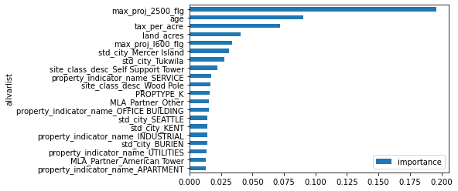
Feature Ranking
Most Important Features for Predicting EC
T-Mobile POR Data
Top Three Features:
Anchor/2500 (Y/N)
L600 (Y/N)
Capacity Other
Urban Planning Parcel Data
Top Three Features:
Age
Tax per Acre
Acres

Slide 5
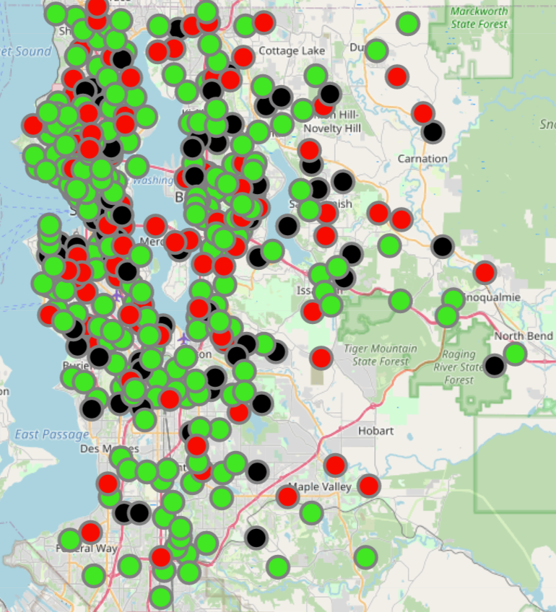
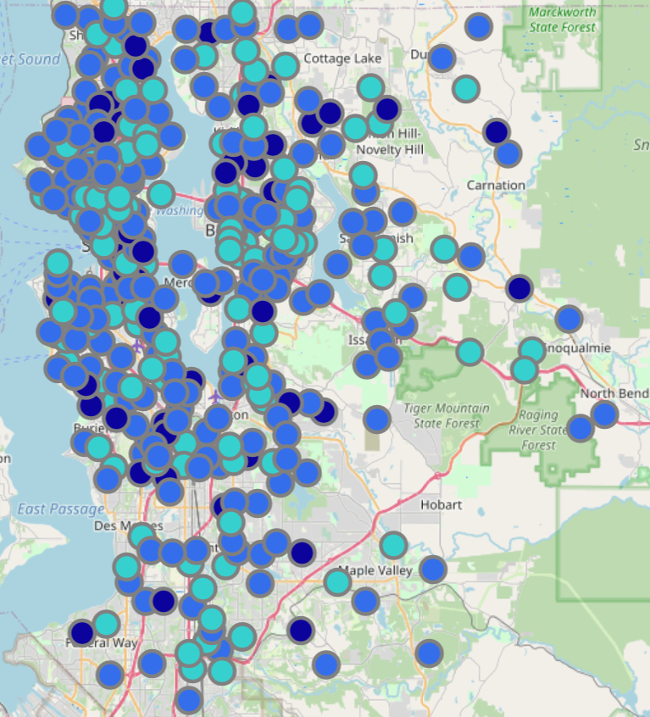
Geographic Analysis
Durations
Residuals
Legend:
<= 8
<= 12
> 12
Legend:
<=1.5
<= 5
> 5
Model performance is not biased to geographic clusters, providing a good indicator that the approach may scale nationally.
Notes:
Notable for not appearing to have any obvious geographic clusters
Duration +- 4 months
Residuals +- 1-2 Months – different colors

Slide 6
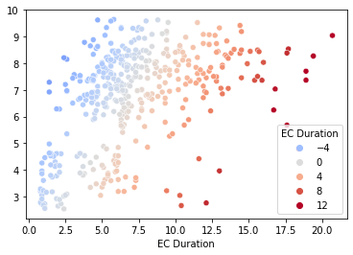
Final Model Analysis
Best Model Performance
Graph Interpretation
Actual EC Duration – 20 Months
Predicted EC Duration – 9 Months
Residual – 11 Months
Predicted EC Duration
Challenge with very large (>12mo) EC Durations. These are 75% Q2-3 of 2020.
Suggest exclusion of COVID-driven outliers
Residuals
-4
0
4
8
12
Actual EC Duration
Notes:
Everything to the left of this line took less time than predicted, everything to the right of this line took more time than predicted

Slide 7
Final Model Performance
Over three dozen model configurations tested:
Model Performance for King County Bars (Lower is better): Cross-validated test MAE
Winning Model:
Random Forest Model
Ridge Cross Validation
Feature manipulation
Variant 1: Covid-impacted data retained – MAE 2.55 (36% within margin)
Variant 2: Covid-impacted data removed – MAE 1.81 (50% within margin)
Performance without Urban Planning data
Variant 1: Covid-impacted data retained – MAE 2.55 (42% within margin)
Variant 2: Covid-impacted data removed – MAE 1.82 (47% within margin)
Magenta Line (Higher is better):
Percent of samples with predicted duration within ±1.5-month margin of error of the true EC duration
Covid Data Retained
Covid Data Removed
Notes:
Without Urban Planning - Covid Data Retained 42%, Covid Data Removed 47%

Slide 8
Data Science Process
Alerting
Re-training
Governance
Model
Tuning
Monitoring
Data
Cleansing
Feature
Engineering
Model
Selection
We have completed model development cycles with King county data. A refresh cycle will be required to nationalize the model. After retraining, requirements and technology should be set to establish an automated, dependable deployment for use.
Notes:
We have gone through one full model development cycle. Time to add more features and data. We have not talked about model deployment. Is there a gameplan for deployment technology and automation?

Slide 9
Recommendations
Project Results
Tested over 3 dozen model configurations and data transformations
Improved model performance
MAE reduction of 24% from 3.35 to 2.55
Percent of samples within ± 1.5 Margin of Error, improvement from 23% to 36%
Further improved performance with Covid-impacted data removed
MAE reduction of 45% from 3.35 to 1.85
Percent of samples within ± 1.5 Margin of Error, improvement from 23% to 50%
Evaluated Urban Planning data impact
Positive impact to percent of projects within margin when using covid data, small negative impact when excluding covid outliers
Next Steps
Build a national level model using lessons learned from King County model
Utilize the Urban Planning data if the 1.5 month margin of error per project is key
Plan production deployment of the model

Slide 10
Feature Cleaning Steps
Outlier Detection & Treatment
Visualized the distribution of variables and detected outliers using Box Plots and the Inter Quartile Range (IQR)
Set the upper and lower limits as 1.5 times of IQR above Q3 (75th quartile) and below Q1(25th quartile), respectively
Capped & floored data points outside of upper and lower limits by replacing with limit values
Null Values Treatment
Categorical – Replaced with the majority class in each variable
Numeric – After removal of outliers, replaced nulls with means
Categorical Features Treatment
Encoded categorical features to numeric quantities using One-Hot Encoding, that creates an additional feature for each group of each categorical feature and mark each observation belonging (Value=1) or not (Value=0) to that group.
Notes:
Set the upper limit as 1.5 times IQR above the 75th percentile
Set the lower limit as 1.5 times IQR below the 25th percentile
Any data points above/below the upper/lower limit replaced with the value of the upper/lower limit
For example, if a house built in 1900 is below the lower limit, the data point would be replaced with the value at the lower limit, 1940.

Slide 11
Models Used
Name | Description
Generalized Linear Model – Tweedie Regressor | Tweedie regression models (TRMs) are flexible tools to deal with non-negative right-skewed data and can handle semi-continuous data, that is, continuous data with probability mass at zero. The geometric sums of Tweedie random variables lead to the geometric Tweedie distributions.
Random Forest | It fits a number of randomized decision trees on various sub-samples of the dataset and uses averaging to improve the predictive accuracy and control over-fitting.
Ridge Cross-Validation | RidgeCV is cross validation method in ridge regression. Ridge Regression is a special case of regression which is normally used in datasets which have multicollinearity.

Slide 12
Features Used
T-Mobile POR Data
Parcel Data
Categorical
prop_type
site_type_desc
site_class_desc
MLA_Partner
MLA_Flag
isurban
Category_v_Capacity_Other
max_proj_l600_flg
max_proj_2500_flg
Numeric
EC Duration
Property Type
Building or structure
Site Class
Partner responsible
MLA (Y/N)
Urban (Y/N)
Capacity Other (Y/N)
L600 (Y/N)
2500 (Anchor) (Y/N)
Response Variable
Categorical
property_indicator_name
std_city
Numeric
tax_per_acre
age
land_acres
Residential/condo/commercial
City name
Tax provided per acre
Age of original building
Total landmass in acres

Slide 13
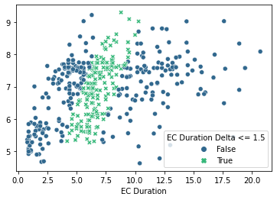
Model Performance
Predicted ECs Within ±1.5 Month Margin of Error
Predicted EC Duration
Actual EC Duration

